Slide 1

Session 02
Grouping and Graphic controls Advance controls

Slide 2
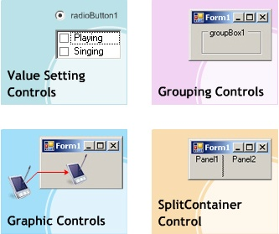
Objectives 1
Value Setting Controls
Grouping Controls
Graphic Controls
SplitContainer Control

Slide 3
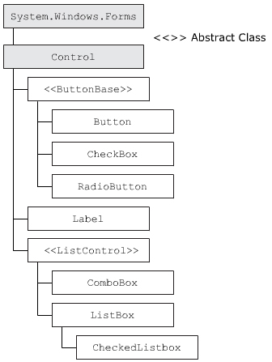
Value Setting Controls
RadioButton
CheckBox
CheckedListBox

Slide 4
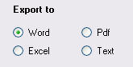
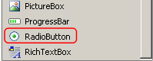
“RadioButton” Control
The RadioButton control allows the user to select a single value from the given set of values.

Slide 5
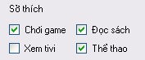
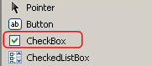
“CheckBox” control
The CheckBox control allows you to accept multiple values from a list of values. This control can be used when you want the user to choose on or more options.

Slide 6
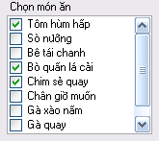
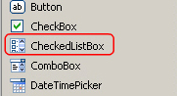
“CheckedListBox” control
The CheckedListBox control is a control that allows you to accept multiple values from a list. The control is similar to a ListBox control, but it display each value in a list along with a check box, which can check or unchecked.

Slide 7
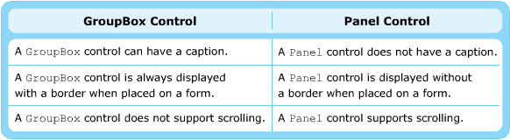
Group Controls
Grouping controls are controls that function as container for other controls. They allow you to logically organize controls in a groups
The common types of grouping controls:
Panel
GroupBox

Slide 8
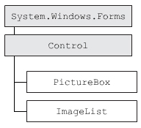
Graphic Controls
Graphic controls are the controls that are used to display graphics on a form. The types of graphic controls commonly used are:
PictureBox
ImageList

Slide 9
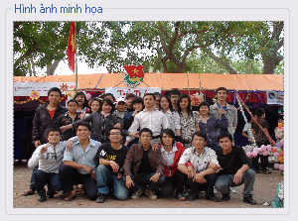
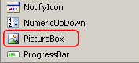
“PictureBox” control
A PictureBox control is used to display images on a form. You can display images as bitmap, GIF, JPEG, metafile, or icon file format using this control.

Slide 10
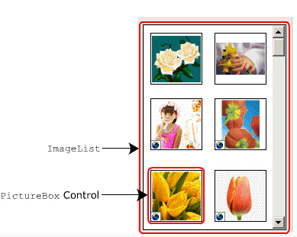
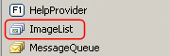
“ImageList” control
The ImageList component in WF is used to store a collection of images. The images stored in this component are displayed by other controls.

Slide 11
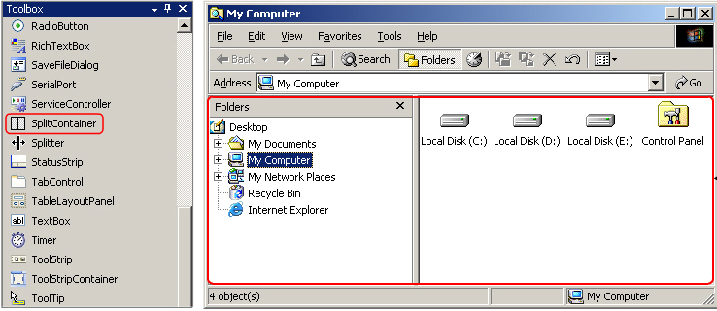
“SplitContainter” control
The SplitContainer control allows you to create complex user interface by dividing the form two resizable panels, either horizontally or vertically.

Slide 12
Objectives 2
ListView and TreeView controls
RichTextBox control
ProgressBar
Date Controls
Timer Component

Slide 13
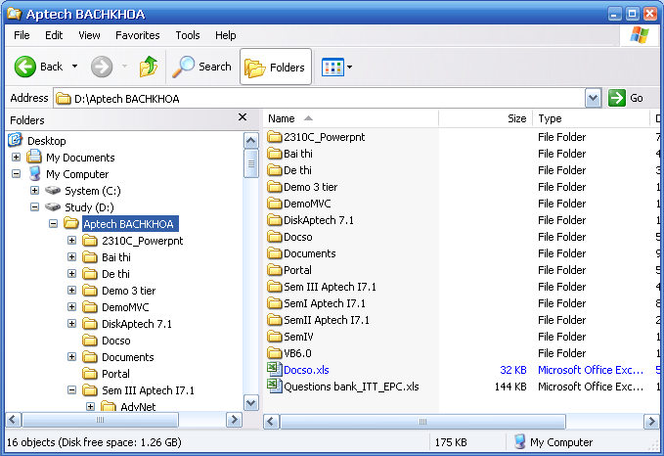
“ListView” and “TreeView” control
TreeView
ListView

Slide 14
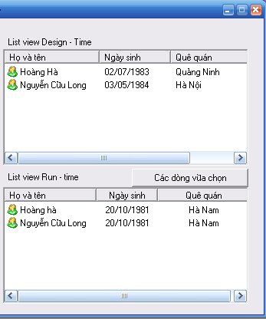
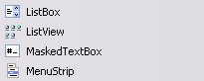
“ListView” Control
The ListView control is used to display a collection of items in a list. This control allows you to add items to a collection and display the items along with their icons.

Slide 15
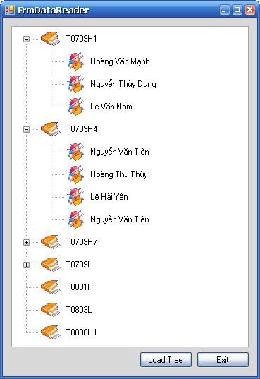
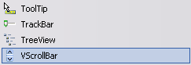
“TreeView” Control
The TreeView control displays data in a hierarchical manner. The Treeview control has three types of nodes.
Root
Parent
Leaf

Slide 16
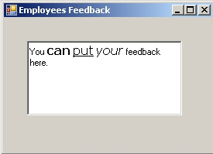
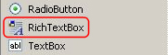
“RichTextBox” Control
The RichTextBox control is used to displaying, entering, and manipulating text data. The control is similar to the WordPad application, as it allows text formatting such as making the text bold, applying bullets and links and changing the font of text. The control also loads text and embedded images from a file

Slide 17
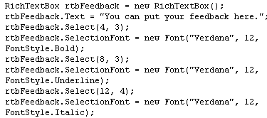
“Font” and “FontStyle” class
You can specify the font, font style, and font size for the text in the RichTextBox control using the SelectionFont property and the Font class.

Slide 18
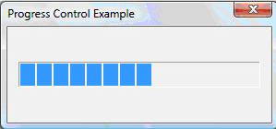
“ProgressBar” Control
The ProgressBar control is a window that can be used indicate the progress of an operation in an application.

Slide 19
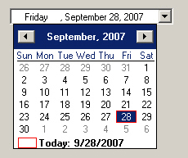
“DateTimePicker” Control
The DateTimePicker control allows you select an item from a list of dates or times.

Slide 20
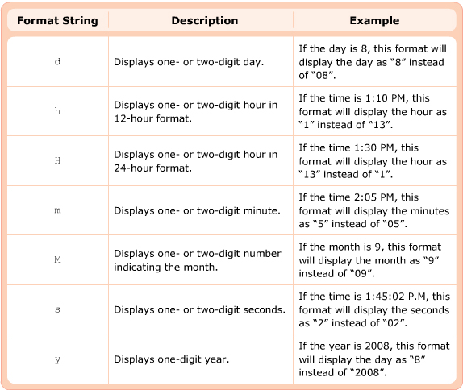
“CustomFormat” Property

Slide 21
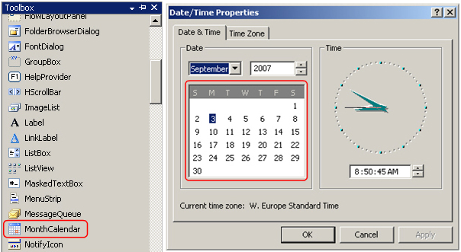
“MonthCalendar” Control
The MonthCalendar control allows you to view and select a date with the help of a graphical calendar.

Slide 22
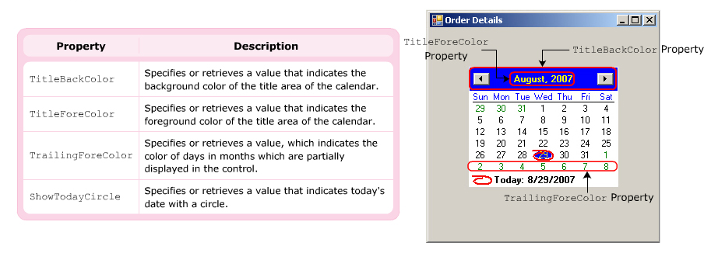
Appearance of “MonthCalendar”

Slide 23
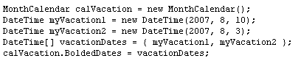
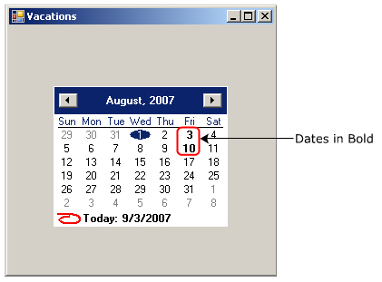
Display Days in “BOLD”

Slide 24
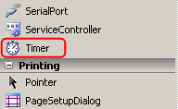
“Timer” Component
The Timer component is a component that generates an event at regular intervals.

Slide 25
Summary and Workshop
Value Setting Controls
Grouping Controls
Graphic Controls
SplitContainer Control
ListView and TreeView controls
RichTextBox control
ProgressBar
Date Controls
Timer Component

Slide 26

THANKS FOR WATCHING !

